Slide 1
Running multiple environments with Docker Compose

Slide 2
Configuration workflow with Docker
Application composition (Not every env will run the whole stack)
Container configuration (Ports…)
Application configuration (The behavior of applications inside containers)

Slide 3
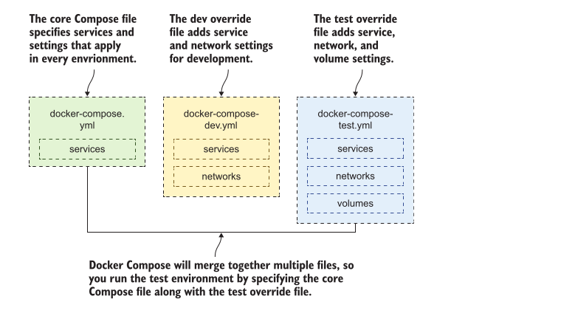
Overriding

Slide 4
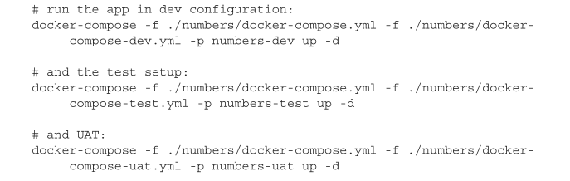
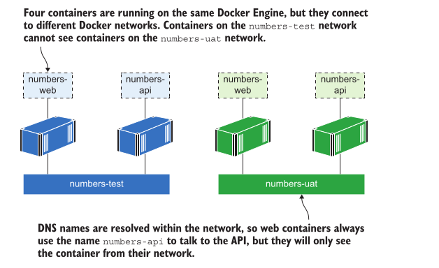

Slide 5
Injecting configuration and secrets
Env. variables
.env file (default env variables)
Env file (override default .env file)
Configuration file set up as a secret

Slide 6
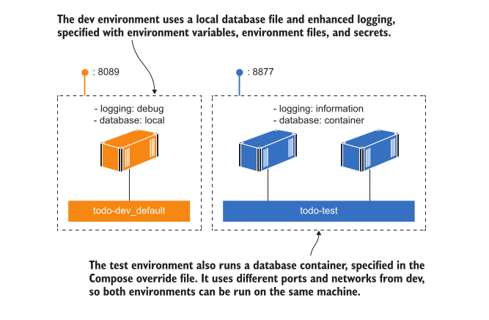
Conclusion
The most important takeaway from this is that the configuration workflow uses the same Docker image in every environment

Slide 7
Building and testing applications with Docker

Slide 8
CI with Docker
In a Dockerized CI process all the har work happens in container, but you still need some infrastructure components to hold everything together
Centralized source code system (Gogs Git server)
Docker registry (Open source Docker registry)
an automation server to run CI jobs (Jenkis)

Slide 9
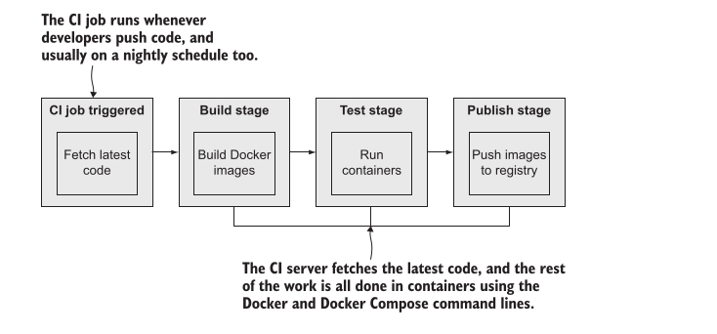
Simple example

Slide 10
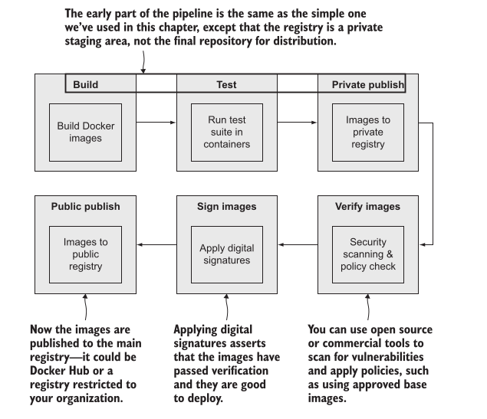
Secure software supply chain

